Slide 1
CREDIT CARD
WEEKLY STATUS REPORT

Slide 2
Project Objective
To develop a comprehensive credit card weekly dashboard that provides real-time insights into key performance metrics and trends, enabling stakeholders to monitor and analyze credit card operations effectively.

Slide 3
Project Insights- Week 52 (24th Dec)
Week on week(WoW) change:
Highest revenue increase by 14.5%,
Total Transaction Amt & Count increased by 143460 & 14.5%
Overview Year to Date(YTD):
Overall revenue is 55M
Total interest is 8M
Total transaction amount is 45M
Male customers are contributing more in revenue 30M, female 25M
Blue credit card is generating highest revenue (83.4%) followed by Silver credit cards (10.1%) then Gold and Platinum cards.
Overall Activation rate is 57.5%
Overall Delinquent rate is 6.07%

Slide 4
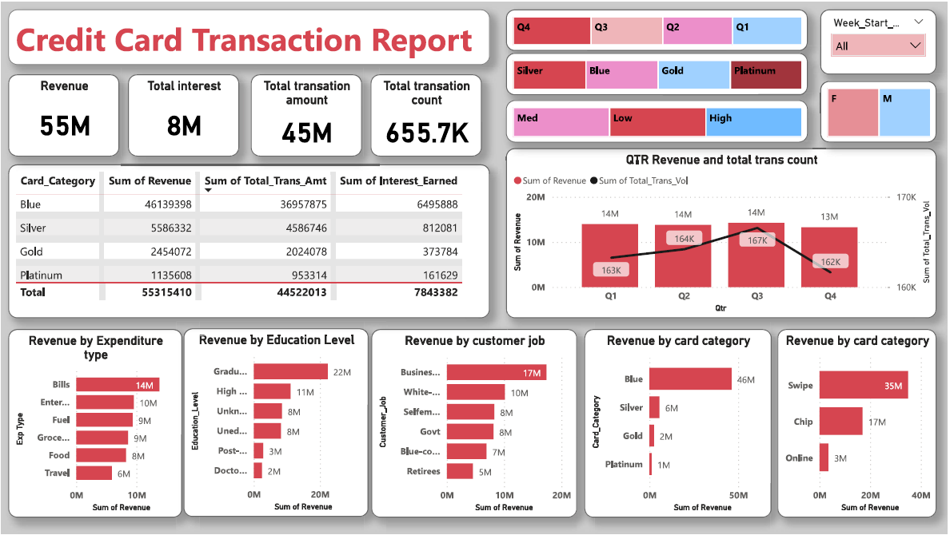

Slide 5
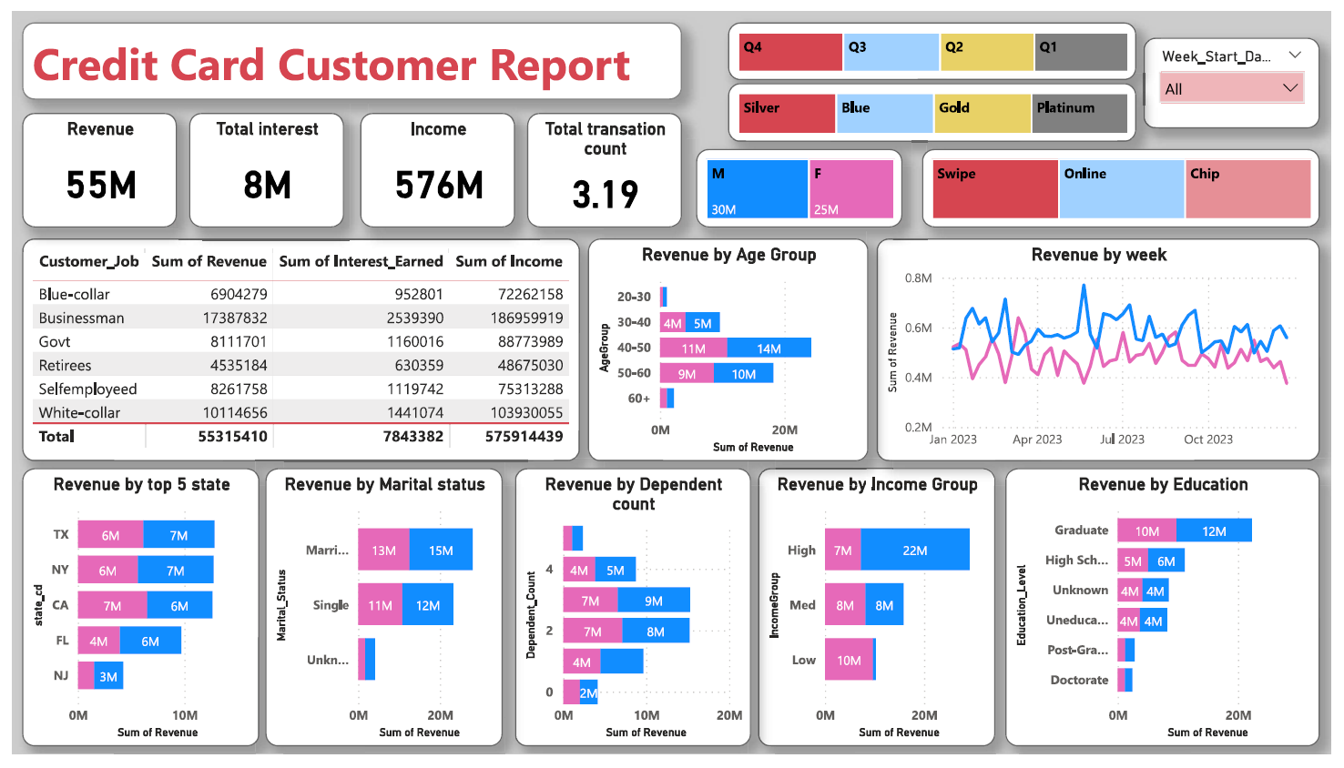

Slide 6
Thank You

